Slide 1
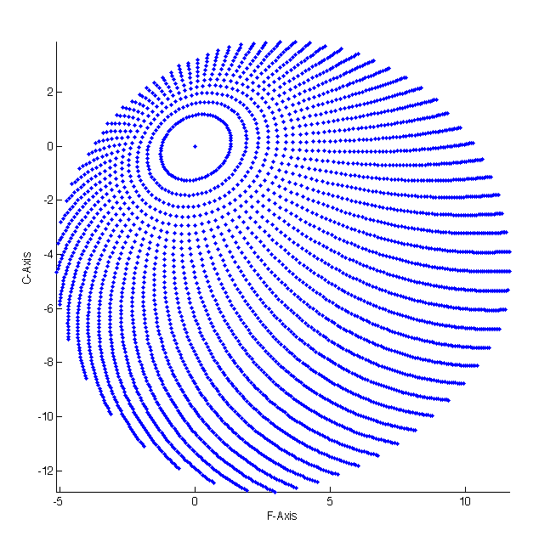
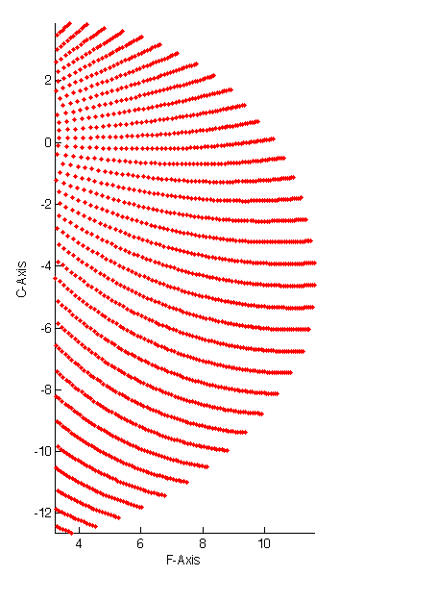
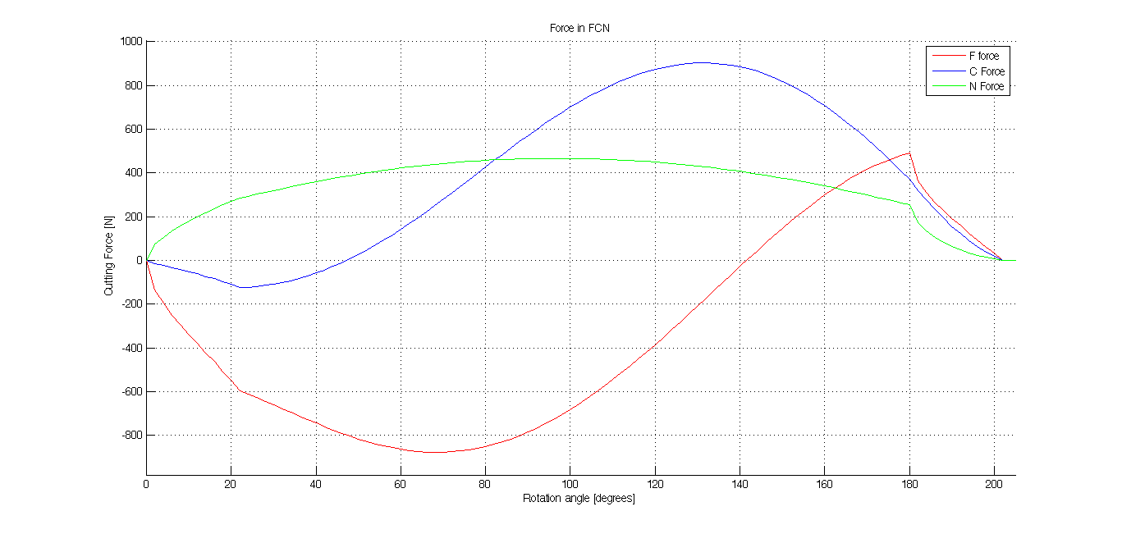
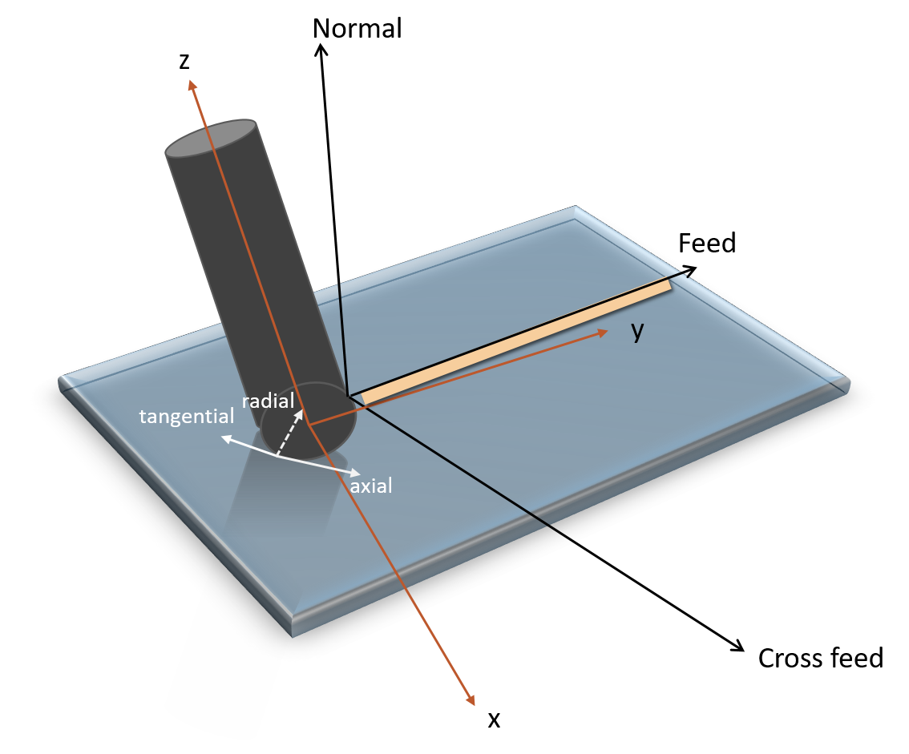
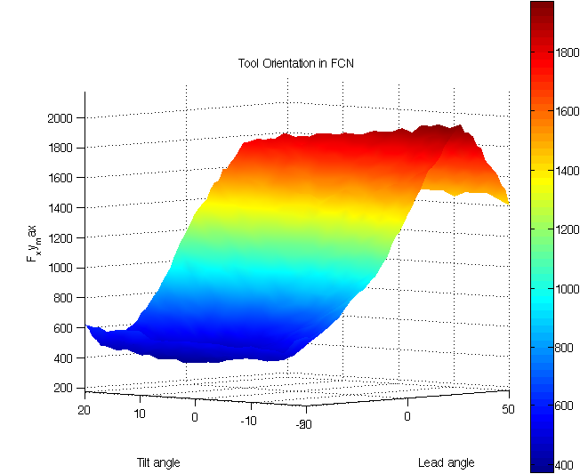
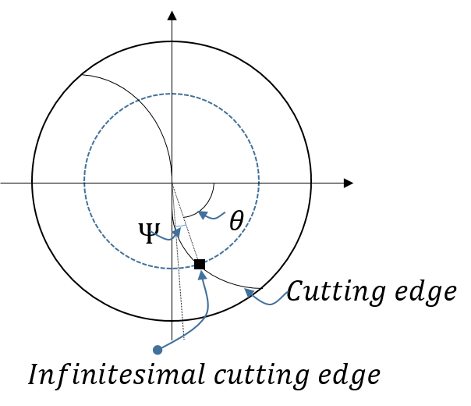
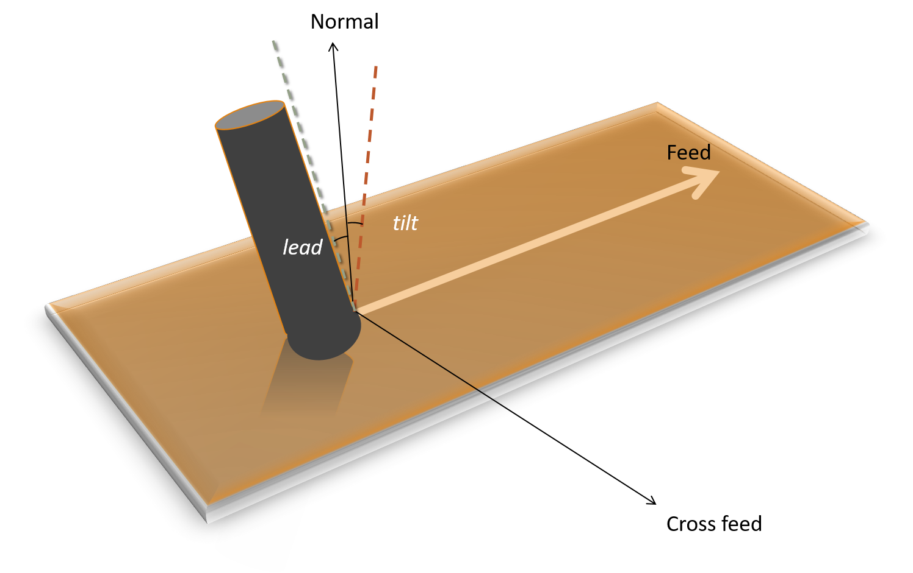
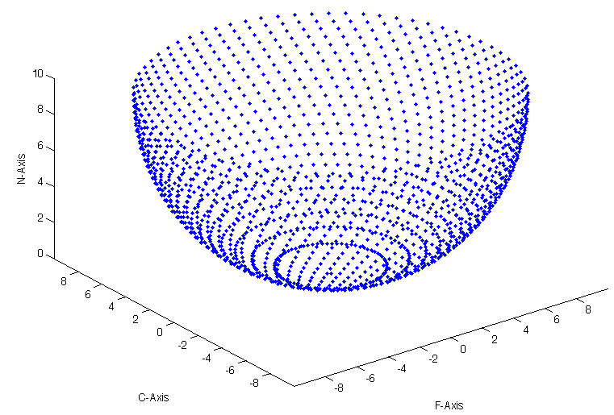
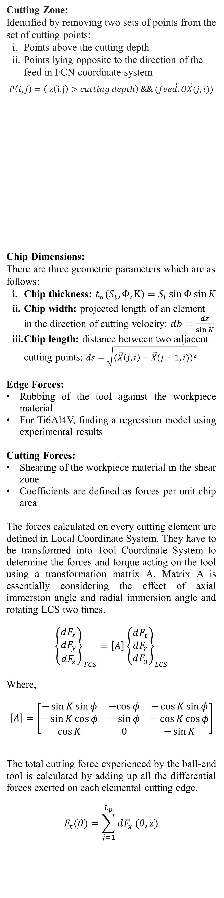
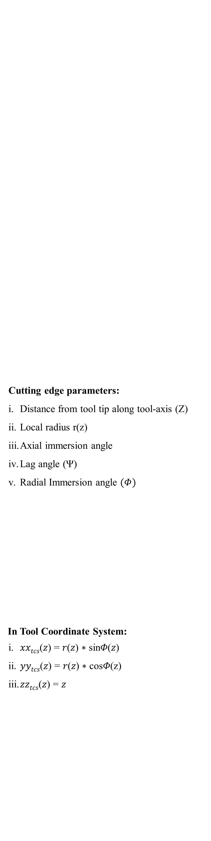
FORCE MODELING FOR OBLIQUE CUTTING
ON NON-PLANAR SURFACES
AYUSH BANDIL ¹ , ASIM TEWARI ^{1,2}
¹ Department of Mechanical Engineering, IIT Bombay
² National Centre for Aerospace Innovation and Research, IIT Bombay
Introduction
Methods
Results
We see technology driven changes in the manufacturing processes everyday across the globe. As technology has been continuously evolving over the last few decades, the demand and importance of lowering the tolerance limit in various industries has been increasing. Industries like aerospace, automotive and die mold machining, are demanding a very high quality of the component which essentially leads to a demand for extremely tight tolerance limit in the manufacturing processes.
Turbine and aircraft structural components are made up of high strength composites containing nickel, aluminium and titanium alloys. These composites exhibit magnificent mechanical properties but conventional 3-axis milling process does not meet the required tolerance limit. This happens because the tool undergoes deflection due to high forces while cutting. Tool wear over time reduces the tool life significantly, and it essentially governs the duration for which the given tool can be used without compromising the quality (or surface roughness) and accuracy (or deviation from desired surface profile) of the machined part. Apart from tool deflection and tool wear, tool accessibility is also an important concern in free form surfaces manufacturing. All of these shortcomings can be solved by taking the conventional milling process to the next level, by introducing two more degrees of freedom, the lead and tilt angles. Lead and tilt angles determine the orientation of the cutting tool. Cutting forces experienced by the tool can be significantly reduced by the selection of appropriate lead and tilt angles under certain machining conditions. It also gives us more accessibility to cut complex shapes.
Many empirical, analytical and numerical models have been developed for the prediction of cutting forces in 5-axis milling process. All the available methods are not very generic in nature and their results are based on some specific cases of workpiece material and tool geometry.
The motivation for this study comes from the fact that being a very crucial subject of study, there exists a literature and experimental gap between the research required in precision machining and research which has been done till date.
The main aim of this project is to develop and generalize the methodology to predict the cutting forces and torque experienced by the tool during the 5-axis milling process. These forces are dependent on various factors such as 1) tool geometry 2) machining parameters like tool orientation, feed, speed, cutting depth and 3) workpiece _{material} characteristics.
Step 1
Establishing coordinate systems for cutting tool as well as workpiece
Mathematical formulation of tool geometry
Step 3
Defining cutting edge parameters
Step 4
Discretization of surface
Step 5
Identification of engagement region (cutting zone)
Step 6
Step 2
Step 7
Step 8
Computation of elemental forces and torques
Transformation of forces and torques to TCS and then FCN
Determining chip dimensions
Determining edge and cutting force coefficients
Step 9
Cutting Zone:
Identified by removing two sets of points from the set of cutting points:
Points above the cutting depth
Points lying opposite to the direction of the feed in FCN coordinate system
$$P\left(i,j\right)=\left( z\left(i,j\right)>cutting depth\right) \&\& (\vec{feed}.\vec{OX}(j,i))$$
Chip Dimensions:
There are three geometric parameters which are as follows:
Chip thickness: $t_{n}(S_{t},Φ,K)=S_{t}\sin{Φ}\sin{K}$
Chip width: projected length of an element in the direction of cutting velocity: $db=\frac{dz}{\sin{K}}$
Chip length: distance between two adjacent cutting points: $ds=\sqrt{{(\vec{X}\left(j,i\right)−\vec{X}(j−1,i))}^{2}}$
Edge Forces:
Rubbing of the tool against the workpiece material
For Ti6Al4V, finding a regression model using experimental results
Cutting Forces:
Shearing of the workpiece material in the shear zone
Coefficients are defined as forces per unit chip area
The forces calculated on every cutting element are defined in Local Coordinate System. They have to be transformed into Tool Coordinate System to determine the forces and torque acting on the tool using a transformation matrix A. Matrix A is essentially considering the effect of axial immersion angle and radial immersion angle and rotating LCS two times.
$${\left\{\begin{matrix}dF_{x} \\ dF_{y} \\ dF_{z}\end{matrix}\right\}}_{TCS}=\left[A\right]{\left\{\begin{matrix}dF_{t} \\ dF_{r} \\ dF_{a}\end{matrix}\right\}}_{LCS}$$
Where,
$$\left[A\right]=\left[\begin{matrix}−\sin{K}\sin{φ} & −cos{φ} & −\cos{K}\sin{φ} \\ −\sin{K}\cos{φ} & −\sin{φ} & −\cos{K}\cos{φ} \\ \cos{K} & 0 & −\sin{K}\end{matrix}\right]$$
The total cutting force experienced by the ball-end tool is calculated by adding up all the differential forces exerted on each elemental cutting edge.
$$F_{x}(θ)=\sum_{j=1}^{L_{p}}{dF_{x}}(θ,z)$$
Cutting edge parameters:
Distance from tool tip along tool-axis (Z)
Local radius r(z)
Axial immersion angle
Lag angle (Ψ)
Radial Immersion angle $(Φ)$
In Tool Coordinate System:
𝑥𝑥_{𝑡𝑐𝑠}(𝑧) = 𝑟(𝑧) ∗ sin𝛷(𝑧)
𝑦𝑦_{𝑡𝑐𝑠}(𝑧) = 𝑟(𝑧) ∗ cos𝛷(z)
𝑧𝑧_{𝑡𝑐𝑠}(𝑧) = 𝑧
Ref: P. Lee and Y. Altintas, “Prediction of ball end milling forces of orthogonal cutting data”
Top view of discretized points below the cutting depth for 20⁰ lead 30⁰ tilt
Top view of discretized points in the cutting zone for 20⁰ lead 30⁰ tilt
Simulated results
Depth of cut = 2.5mm
Lead and tilt angles for minimum force on
the cutting tool are -20⁰ and 4⁰ respectively.
As we increase the depth of cut, the lead and tilt angles also need to be increased in magnitude to get the minimum value of F_{xymax}
References
Ozturk, E., and Erhan Budak. "Modeling of 5-axis milling processes." Machining Science and Technology 11.3 (2007): 287-311.
Altintas, Y. Manufacturing automation: metal cutting mechanics, machine tool vibrations, and CNC design. Cambridge University Press, 2012.
Lee, P., and Y. Altintaş. "Prediction of ball-end milling forces from orthogonal cutting data." International Journal of Machine Tools and Manufacture 36.9 (1996): 1059-1072.
Acknowledgement
The authors gratefully acknowledge the partial support provided for this work by National Centre for Aerospace Innovation and Research (NCAIR) at Indian Institute of Technology Bombay (IIT Bombay), a Department of Science and Technology - Government of India, The Boeing Company and IIT Bombay collaboration.

